Slide 1
Data Mining
and
Machine learning

Slide 2
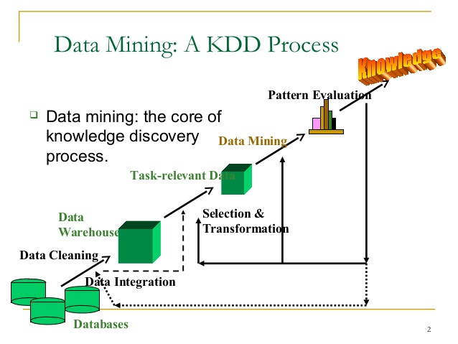
DATA MINING
What is Data Mining ?
Data Mining is defined as a process of discovering patterns in a large data set.
Many organizations use the process of Data Mining to turn raw data into useful information.
Various kinds of softwares are used by businesses to look for patterns in large batches of data.
With the help of Data mining businesses can learn more about their customers to develop a more effective marketing strategy, increase sales and decrease costs

Slide 3
Applications:
Banking / Finance
Sales / Marketing
Healthcare
Transportation
Hospitality Industry
Education

Slide 4
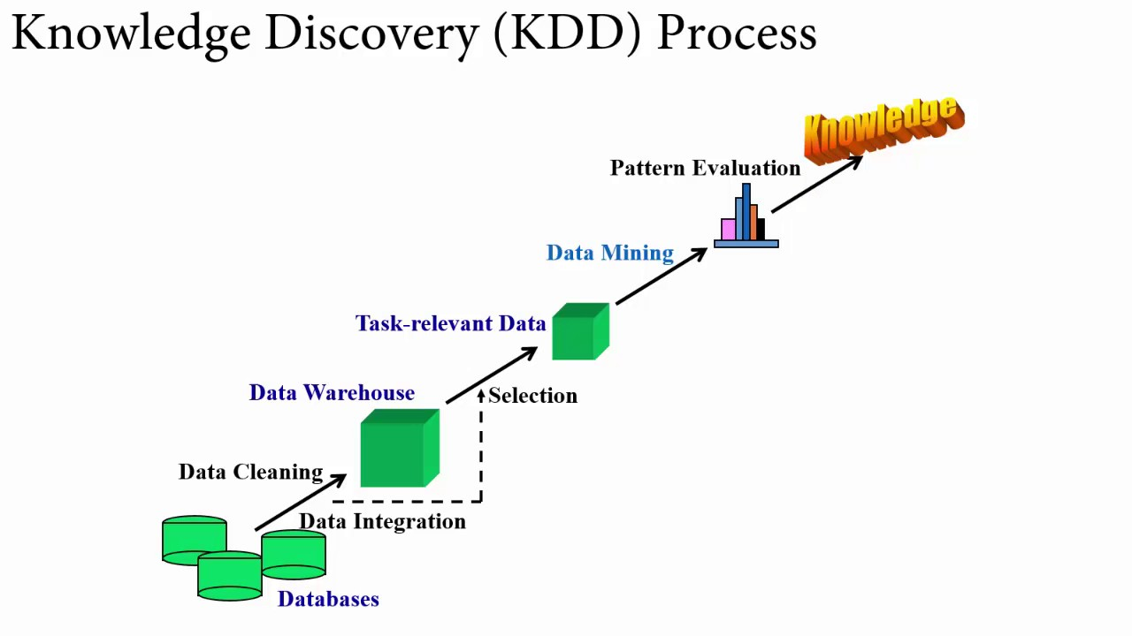

Slide 5
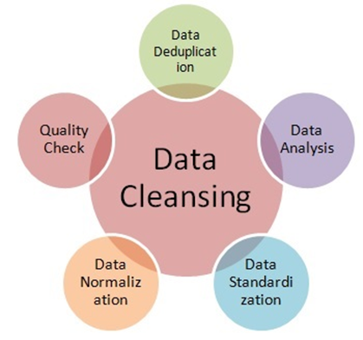
The KDD Process :
Step1: Data Cleaning
identify incomplete,inaccurate or inconsistent data and modify the data by deleting incorrect information

Slide 6
Step 2: Data Integration :
Data integration is defined as heterogeneous data from multiple sources
combined in a common source(Data Warehouse).
ETL(Extract-Load-Transformation)
Step 3: Data Selection:
Data selection is defined as the process where data relevant to the analysis is decided and retrieved from the data collection.
Data selection using Decision Trees.
Data selection using Clustering, Regression, etc.

Slide 7
Step 4: Data Transformation
Data Transformation is defined as the process of transforming data into appropriate form required by mining procedure.
Step 5: Data Mining
Data mining is defined as clever techniques that are applied to extract patterns potentially useful.

Slide 8
Step 6: Pattern Evaluation
Pattern Evaluation is defined as as identifying strictly increasing patterns representing knowledge based on given measures.
Find interestingness score of each pattern.
Uses summarization and Visualization to make data understandable by user.
Step 7: Knowledge representation:
Knowledge representation is defined as technique which utilizes visualization tools to represent data mining results.
Generate reports.
Generate tables.

Slide 9
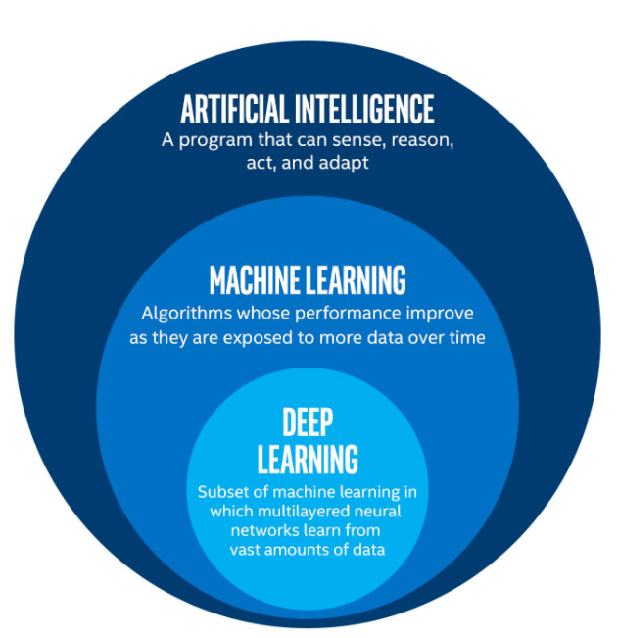
What is Machine Learning:
It’s the design, study, and development of algorithms that permit machines to learn without human intervention. It’s a tool to make machines smarter, eliminating the human element
It is an application of AI.

Slide 10
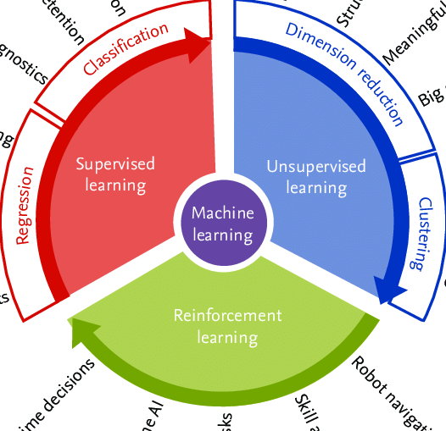
Types of Machine Learning:
Supervised learning
Unsupervised learning
Reinforcement Learning

Slide 11
Supervised Learning:
Supervised learning as the name indicates the presence of a supervisor as a teacher.
Basically supervised learning is a learning in which we teach or train the machine using data which is well labeled that means some data is already tagged with the correct answer.
After that, the machine is provided with a new set of examples(data) so that supervised learning algorithm analyses the training data(set of training examples) and produces a correct outcome from labeled data.
Common algorithms in supervised learning include logistic regression, naive bayes, support vector machines, artificial neural networks, and random forests.

Slide 12
List of Supervised Algorithms explained:
Regression:
Linear Regression
Logistic Regression
Classification:
Naive Bayes

Slide 13
Linear Regression
Let us consider at a simple regression model of life satisfaction:
Life_satisfaction = θ0 + θ1 X GDP_per_capita
This model is a linear function of the input feature GDP_per_capita. θ0 and θ1 are
known as the model’s parameters. A linear model predicts by computing a weighted sum of the input features and adds a constant called the bias as shown in Equation:

Slide 14
Linear Regression model prediction
y = θ0 + θ1x1 + θ2x2 + ⋯ + θnxn
• ŷ is the predicted value.
• n is the number of features.
• xi is the ith feature value.
• θj is the jth model parameter (including the bias term θ0 and the feature weights
θ1, θ2, ⋯, θn).

Slide 15
The vectorized form of the equation is as shown below in Equation
Linear Regression model prediction (vectorized form):
y = hθ (x) = θ^T . x
• θ is the model’s parameter vector, containing the bias term θ0 and the feature
weights θ1 to θn.
• θ^T is the transpose of θ (a row vector instead of a column vector).
• x is the instance’s feature vector, containing x0 to xn, with x0 always equal to 1.
• θ^T . x is the dot product of θ^T and x.
• hθ is the hypothesis function, using the model parameters θ.

Slide 16
That’s the Linear Regression model, Now the question arises that how do we train this model? Training a model simply means setting its parameters so that the model best fits the training set. A measure of how well (or poorly) the model fits
the training data is needed for this.
Root Mean Square Error (RMSE) is the easiest measure for this.

Slide 17
Thus,
to train a Linear Regression model, we will need to find the value of θ that minimizes
the Cost Function i.e. RMSE. It is much simpler to minimize the Mean Square Error (MSE)
than the RMSE, and it ultimately gives the same outcome. (because the value that minimizes a
function also minimizes its square root).
The MSE of a Linear Regression hypothesis hθ on a training set X is calculated using
Equation given below

Slide 18
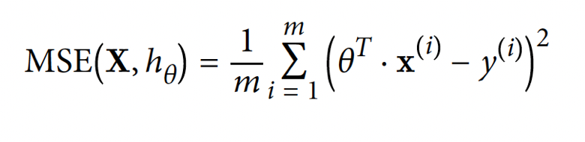
MSE cost function for a Linear Regression model
We write hθ instead of just h in order to make it clear that the model is parametrized by the vector θ. To simplify notations, we will just write MSE(θ) instead of MSE(X, hθ).

Slide 19
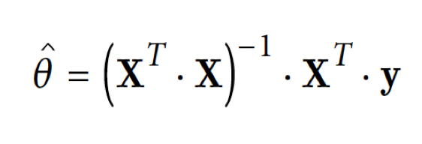
The Normal Equation
To find the value of θ that minimizes the cost function, there is a mathematical equation that gives the result directly. This is called
the Normal. This equation is as shown below:
• θ(hat) is the value of θ that minimizes the cost function.
• y is the vector of target values containing y(1) to y(m).

Slide 20
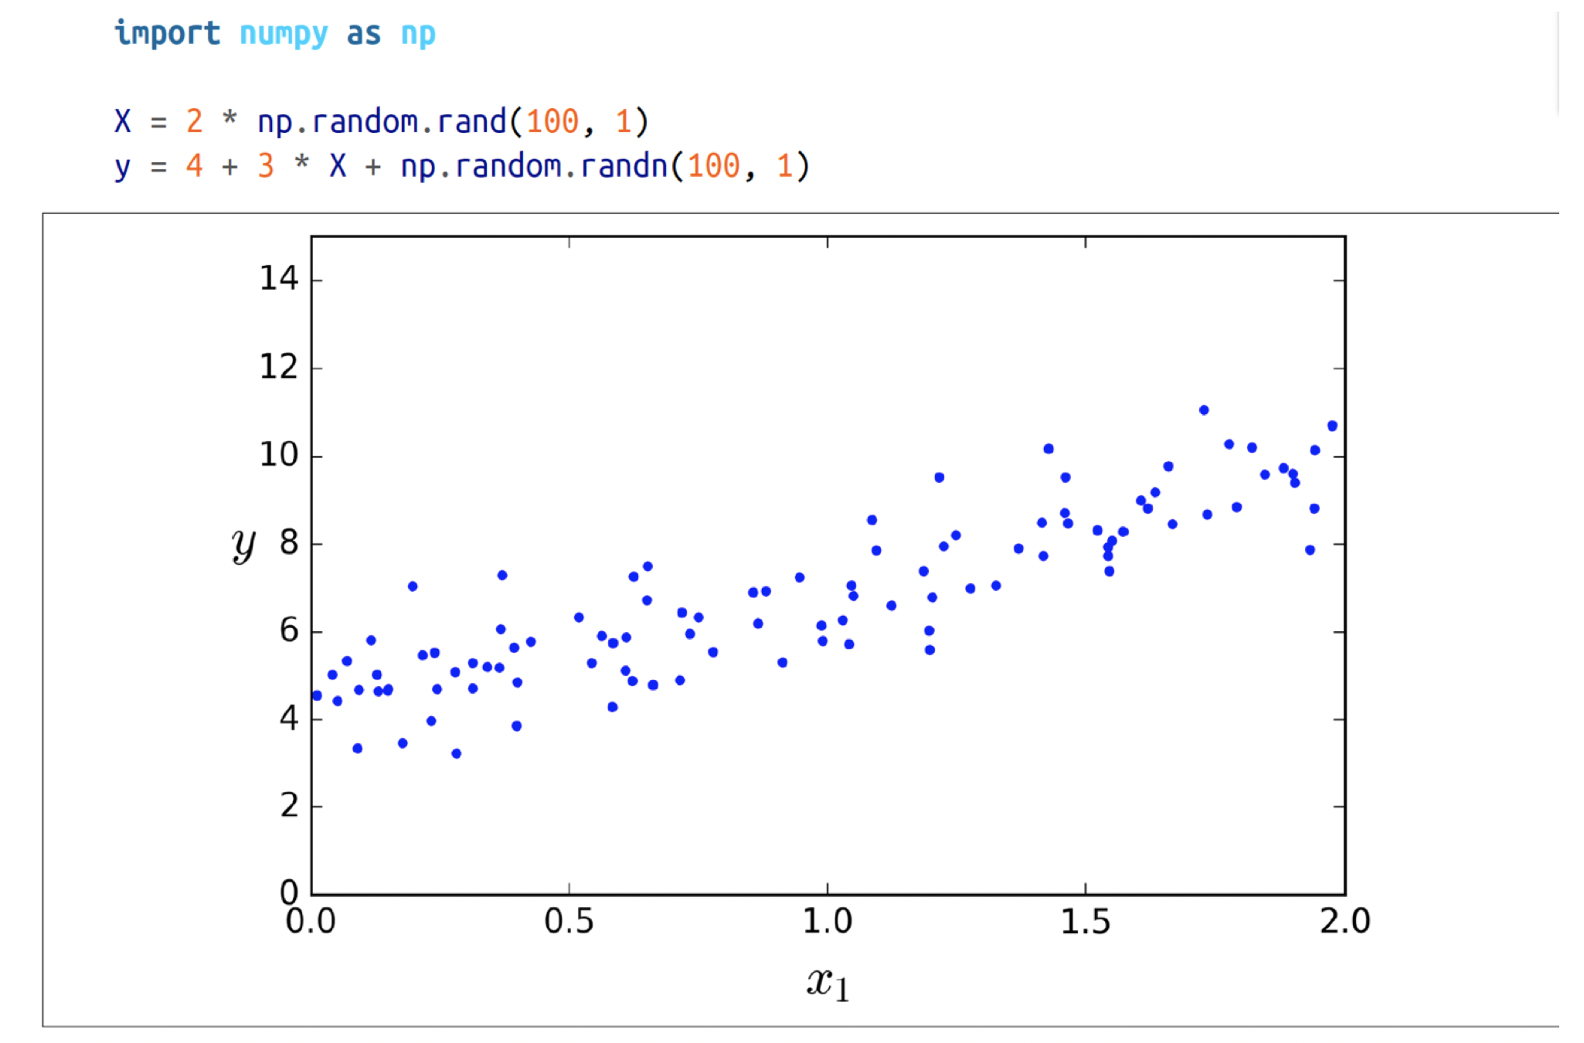
Below we generate some linear-looking data to test this equation on (Figure 4-1):

Slide 21
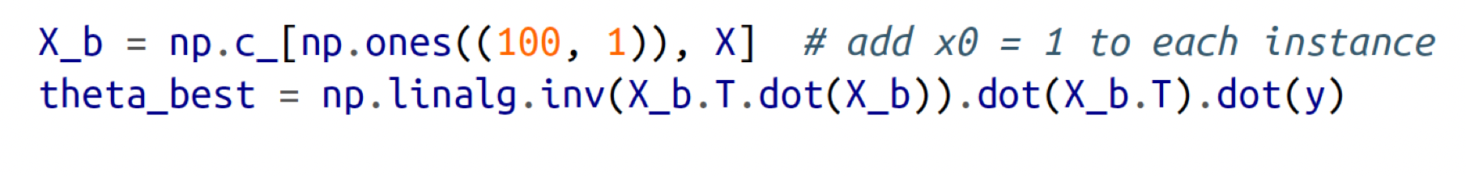
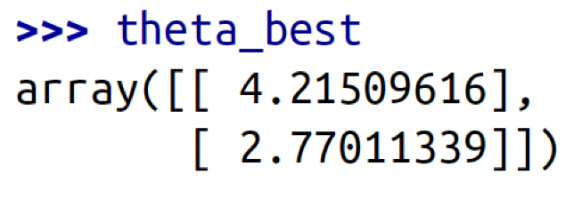
The θ is then computed using the Normal Equation. We will use the inv() function from
NumPy’s Linear Algebra module (np.linalg) to compute the inverse of a matrix, and
the dot() method for matrix multiplication:
The actual function that we used to generate the data is y = 4 + 3x0 + Gaussian noise.
Let’s see what the equation found:
We would have hoped for θ0 = 4 and θ1 = 3 instead of θ0 = 3.865 and θ1 = 3.139. Close
enough, but the noise made it impossible to recover the exact parameters of the original
function.

Slide 22
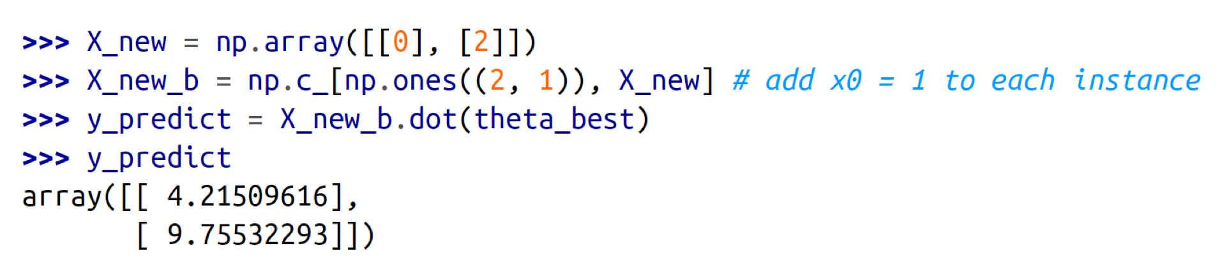
Now we can make predictions using θ:

Slide 23
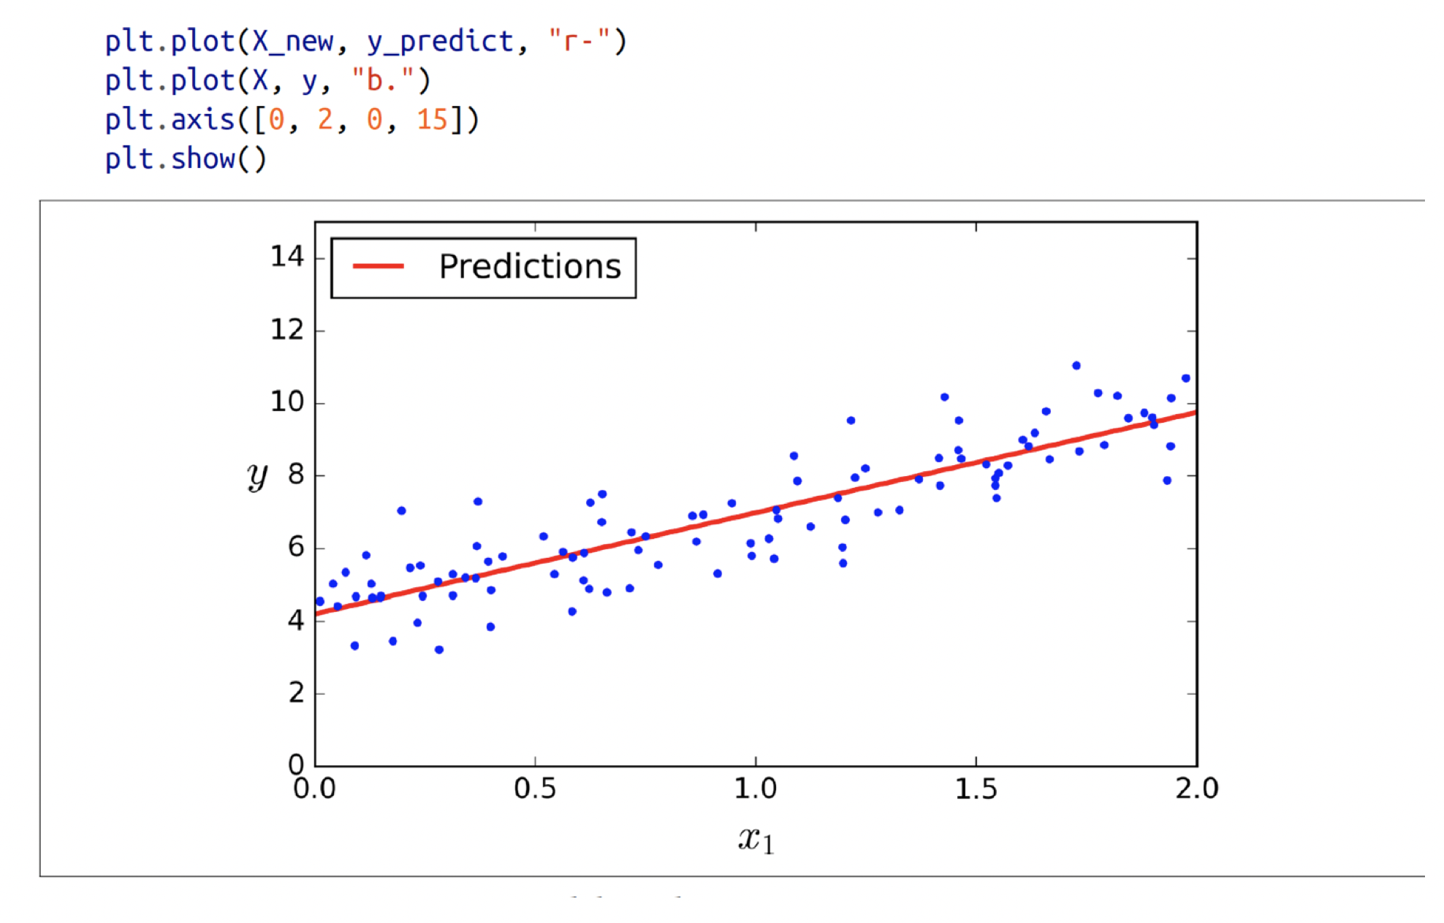
Let’s plot this model’s predictions (Figure 4-2):

Slide 24
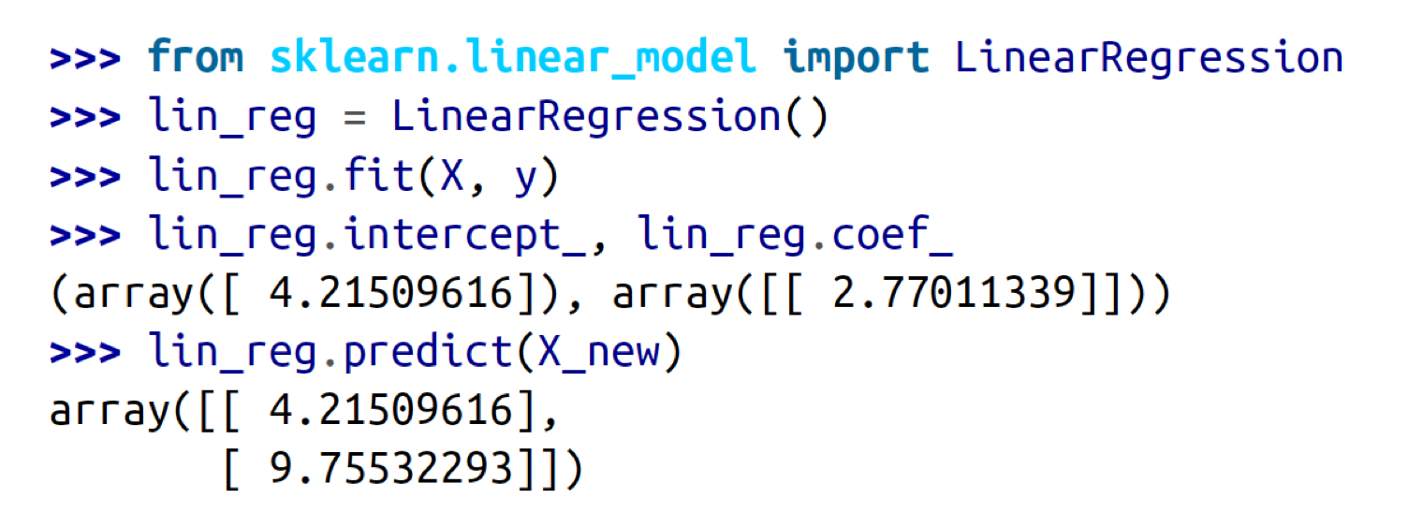
The equivalent code using Scikit-Learn looks like this:

Slide 25
Logistic Regression
Logistic Regression is mainly used for classification.
In Logistic Regression we predict the probability of a categorical dependent variable.
For instance, we want to predict whether an email is spam or not (i.e. 0 or 1) or a tumour is malignant or not (0 or 1). Linear Regression will not be a suitable fit for such classification problems. So we can solve it using Logistic Regression.

Slide 26
Types of Logistic Regression
1. Binary Logistic Regression
Here we have only two 2 possible outcomes as the response. For example: Spam or Not
2. Multinomial Logistic Regression
Here we have three or more categories without ordering. Example: Prediction of which food is preferred more (Veg, Non-Veg, Vegan)
3. Ordinal Logistic Regression
Here we have three or more categories with ordering. Example: Movie rating from 1 to 5

Slide 27
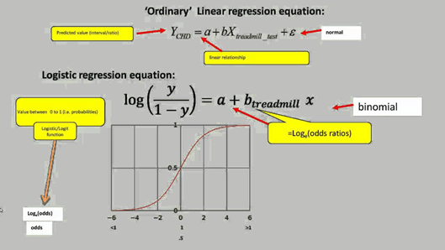
Equation

Slide 28
Applications
Logistic Regression is used for Trauma and Injury Severity Score (TRISS), which is widely used to predict mortality in injured patients.
Logistic regression can be used to predict the risk of developing a given disease (e.g. diabetes; coronary heart disease), based on observed characteristics of the patient (sex, age, body mass index, results of various blood tests, etc.).
Logistic Regression can also be used to predict a customer’s propensity to purchase a product or halt a subscription, etc.
It can also be used in engineering, especially for predicting the probability of failure of a given process, system or product.

Slide 29
Example :
Goal: Build a logistic regression model in Python in order to determine whether candidates would get admitted to a university based on GRE Score, GPA and Work Experience
Possible Outcomes: Admitted (1), Rejected (0)

Slide 30
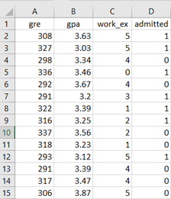
Dataset: We use a sample dataset of 25 observations
Top 15:

Slide 31
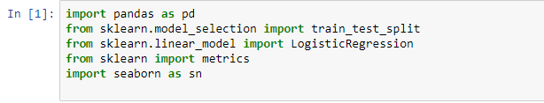
STEP 1: Importing required packages
STEP 2: Importing Data

Slide 32

STEP 3: Set Independent and Dependent variables
STEP 4: Split Training and Test data. (Test data = 25% of total data)

Slide 33
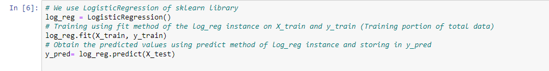
STEP 5: Apply Logistic Regression
STEP 6: Accuracy of our Regression

Slide 34
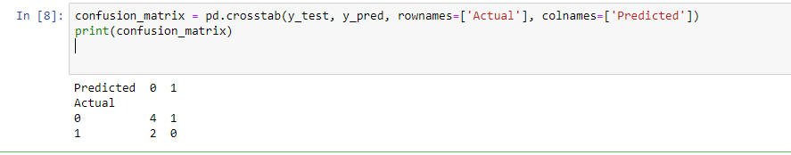
STEP 7: Confusion Matrix for our predicted values
(Note: In above example we got a very low accuracy due to smaller dataset chosen. The dataset was chosen only for demonstrating Logistic Regression fundamentals.)

Slide 35
Naive Bayes:
A Naive Bayes Classifier is a supervised machine-learning algorithm that uses the Bayes’ Theorem, which assumes that features are statistically independent. The theorem relies on the naive assumption that input variables are independent of each other, i.e. there is no way to know anything about other variables when given an additional variable. Regardless of this assumption, it has proven itself to be a classifier with good results.

Slide 36

Naive Bayes:
The likelihood that an event (A) will happen given that another event (B) has already happened. Essentially, the theorem allows a hypothesis to be updated each time new evidence is introduced. The equation below expresses Bayes’ Theorem in the language of probability:

Slide 37
Let’s explain what each of these terms means.
“P” is the symbol to denote probability.
P (A | B) = The probability of event A (hypothesis) occurring given that B (evidence) has occurred.
P (B | A) = The probability of the event B (evidence) occurring given that A (hypothesis) has occurred.
P(A) = The probability of event B (hypothesis) occurring.
P(B) = The probability of event A (evidence) occurring.

Slide 38
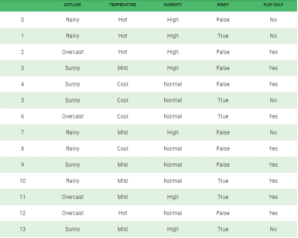
Find the probability of “Not playing golf” given that the weather conditions are “Rainy outlook”, “Temperature is hot”, “high humidity” and “no wind”.

Slide 39
Now, its time to put a naive assumption to the Bayes’ theorem, which is, independence among the features. So now, we split evidence into the independent parts.
Now, if any two events A and B are independent, then,
P(A,B) = P(A)P(B)

Slide 40
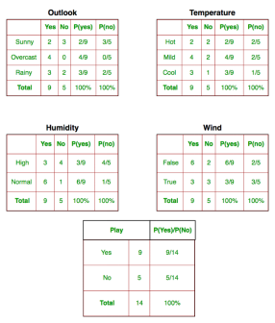

Slide 41
today = (Sunny, Hot, Normal, False)
P(Yes|Today) >P(No|Today):
So, prediction that golf would be played is ‘Yes’.

Slide 42
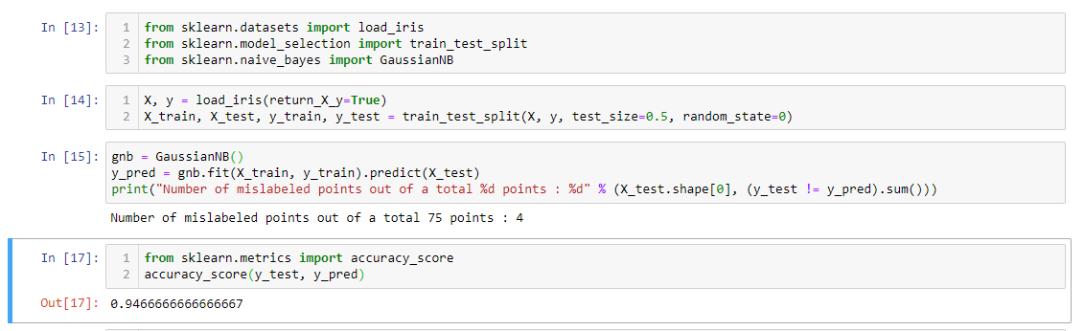

Slide 43
Unsupervised Learning:
Unlike supervised learning, no teacher is provided that means no training will be given to the machine.
Here the task of machine is to group unsorted information according to similarities, patterns and differences without any prior training of data.
Unsupervised Learning is mainly used in Clustering (k-means)

Slide 44
List of Unsupervised algorithms explained:
Hierarchical Clustering
K-Means Clustering
PCA (Principal Component Analysis)

Slide 45
Hierarchical Clustering
Cluster analysis or clustering is the task of grouping a set of objects in such a way that objects in the same group (called a cluster) are more similar (in some sense) to each other than to those in other groups (clusters).
What is Hierarchical?
Most common approach is where all objects start as separate clusters and then are joined sequentially such that each step forms a new cluster joining by two clusters at a time until only a single cluster remains

Slide 46
Two approaches:
1) Divisive clustering: All the data is in a single cluster and then splits it and all subsequent clusters until each data point is its own individual cluster.
2) Agglomerative clustering: Each data point is its own cluster, and then they are paired together in a hierarchy until there is 1 cluster.

Slide 47
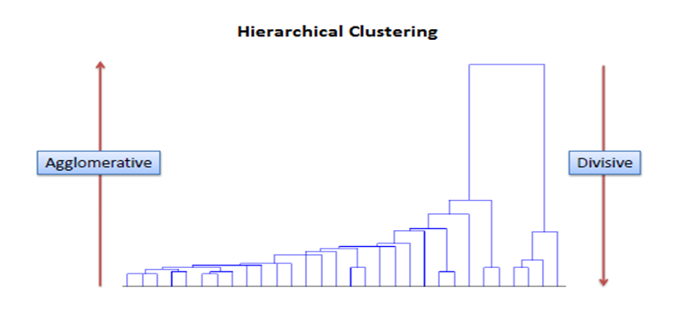

Slide 48
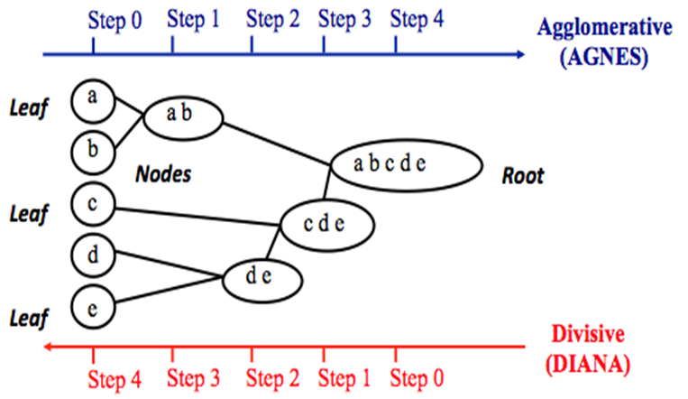
A multiple step Process

Slide 49
Most widely used algorithms:
ward.D2 - When using hclust() there are a few algorithms to choose from. Ward D2 is often used because of its speed and practicality.
ward.D - creates groups that are roughly equal in size, but distance matrix is squared ward.D2 - creates groups that are roughly equal in size, standard distance matrix is used, compact spherical
single - minimal distance of any object within a cluster and another object
complete - distance is measured between the maximum distance of any object within a cluster and another object average - use the average distances between points
mcquitty - an algorithm that uses mean distances, but does not re-calculate them, making it faster
median - use the median distance between points
centroid - diﬀerence between centroids between clusters

Slide 50
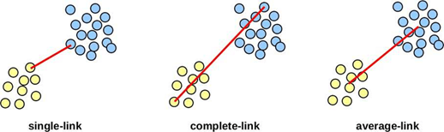
Figure to show single complete average linkage

Slide 51
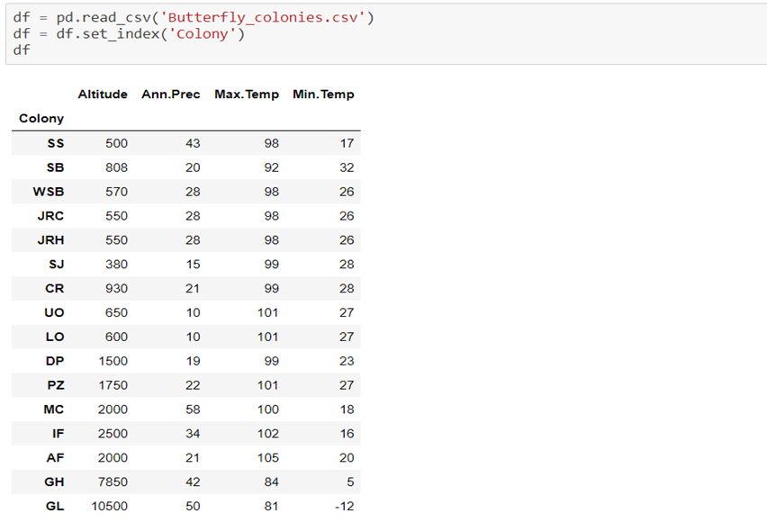
Here we have taken a data of 16 colonies of butterfly and we will use hierarchical technique to combine colonies that have most similar kind of butterfly in characteristics.

Slide 52
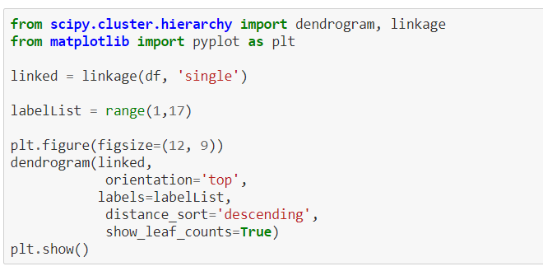
Below is the python code to plot dendrogram for this and we have used single linkage method here.

Slide 53
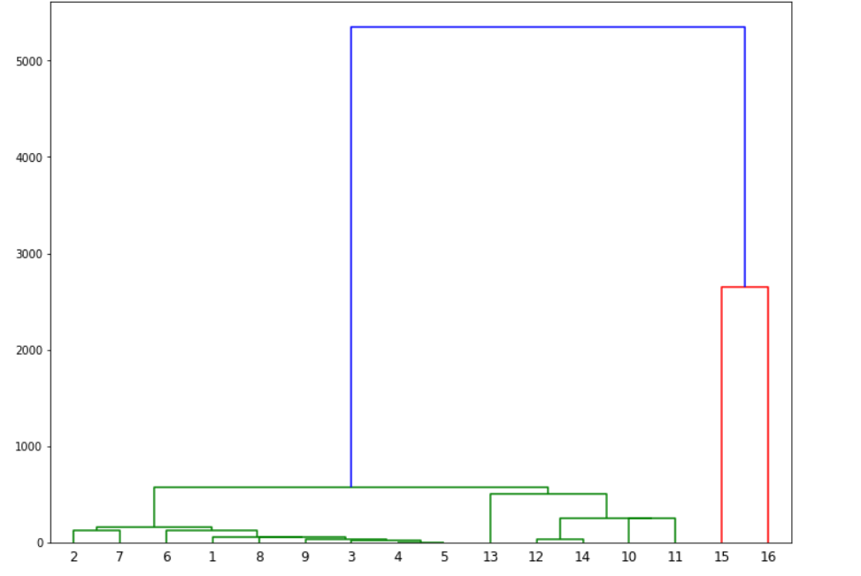
This is our dendrogram which shows the hierarchical clustering of butterfly colonies.

Slide 54
K-means clustering
Unsupervised learning algorithm
No target variable
Analysing hidden pattern
Clusters are formed between two variables that have some properties in common

Slide 55
How does K-means work?
Randomly choose centroids k
Determine the Euclidean distance between each centroid and the data points
Cluster the points based on the minimum distance around the centroid
Breaking the ice and not a reliable approach

Slide 56
Distances in K-Means
There are three important distances in K-means algorithm.
In-between distance: The in-between distance is the sum of distances between different clusters.
Within distance: The within distance is the sum of distances between each pair points that belong to the same cluster.
Total distance: The total distance is the sum of distance between the data points irrespective of the clusters.
Total Distance = In-between distance + Within distance

Slide 57
Deciding the optimal K
Elbow method
The curve of the elbow determines optimal K

Slide 58
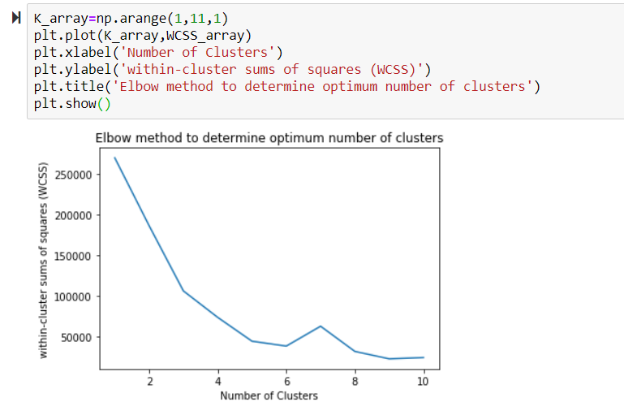
Determining the optimal K

Slide 59
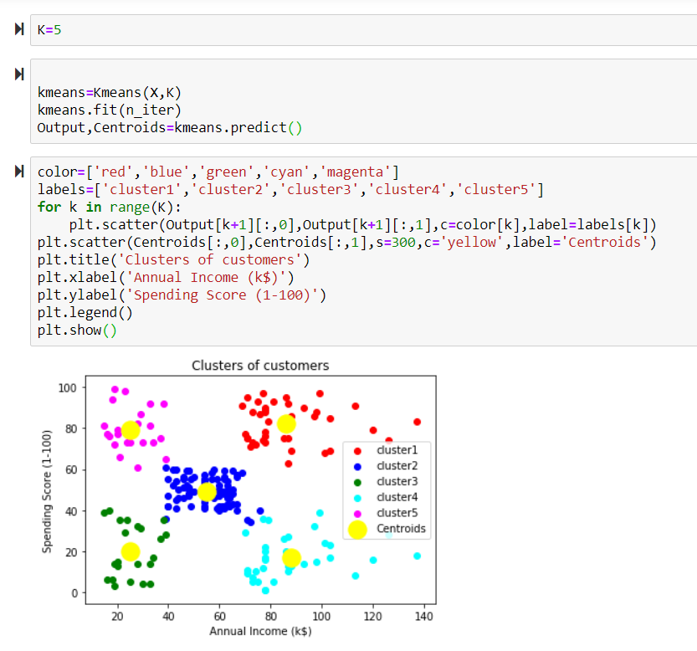
Implementing KMeans Clustering

Slide 60
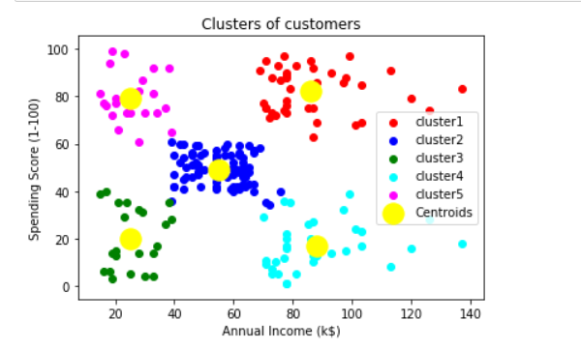
Interpretation

Slide 61
Applications of K-Means Clustering
Market segmentation
Search engines
Weather/Crime

Slide 62
Principal Component Analysis Objectives
•Number of variables in data is called dimensions.
•PCA aim is to reduce dimensionality while accounting for as much of the original variation as possible
•This is achieved by transforming to new set of variables called principal components that are linear combinations of original variables.
•These new sets of variables, or principal components, are uncorrelated and ordered
•As a result, first few of the principal components account for most of the variations in all the original variables

Slide 63
PCA: Applications
•PCA as an end to explain the data
•Graphical representation of data
•Input to some other analysis
•Exploratory technique (most often used for this purpose)

Slide 64
PCA: Sample Size
•Convention says number of observations, n, should be between 50 to 400
•Convention says to maintain a ratio of 5:1 between n and p, where q is the number of variables
•Latest research shows that it is best when both n and ratio of n:p are large

Slide 65
PCA: R Functions
•stats::princomp() or stats::prcomp(). In general, they produce similar results. prcomp() is preferable
•Option scale = TRUE means that principal components are computed on the correlation matrix
•Print(pca.results) show singular values of the correlation or covariance matrix
•Use plot(pca.results) or biplot(pca.results) to visualize. The ”bi” in biplot represents display of variances and covariances of the variables and distances in the same plot
•Other R functions that offer PCA are FactorMineR::PCA(), ade4::dudi.pca(), vegan::rda(), amap::acp()

Slide 66
A Summary of the PCA Approach
- Standardize the data.
- Obtain the Eigenvectors and Eigenvalues from the covariance matrix or correlation matrix, or perform Singular Vector Decomposition.
- Sort eigenvalues in descending order and choose the $k$ eigenvectors that correspond to the $k$ largest eigenvalues where $k$ is the number of dimensions of the new feature subspace ($k \le d$)/.
- Construct the projection matrix $\mathbf{W}$ from the selected $k$ eigenvectors.
- Transform the original dataset $\mathbf{X}$ via $\mathbf{W}$ to obtain a $k$-dimensional feature subspace $\mathbf{Y}$.

Slide 67
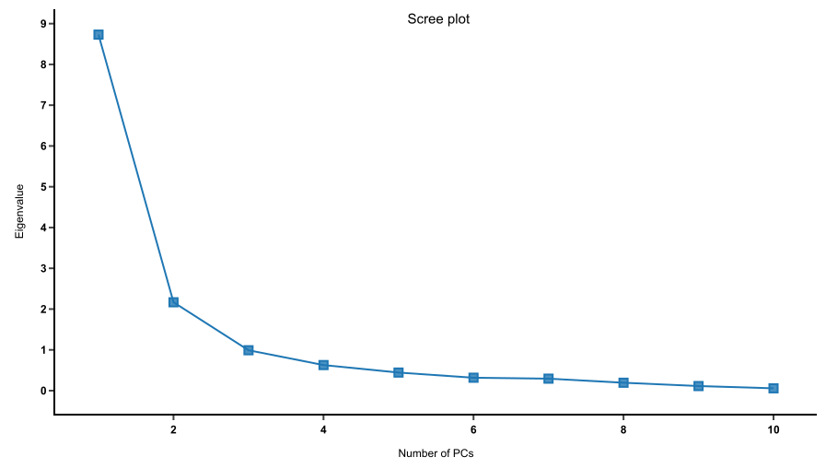
This is the Scree plot which we get as a result in this algorithm. From the plot it can be deciphered that only PC1 contributes good amount of variance with them. Hence we can use only PC1 for further analysis.

Slide 68
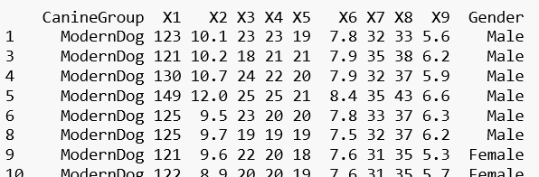
Now we will take example of different breed of dogs data whose nine skull measurements are given.There are 9 measurements and we will try to see how this 9 columns can be reduced to less columns if applicable.

Slide 69
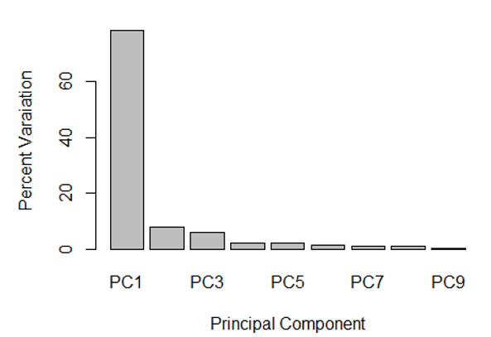

Slide 70
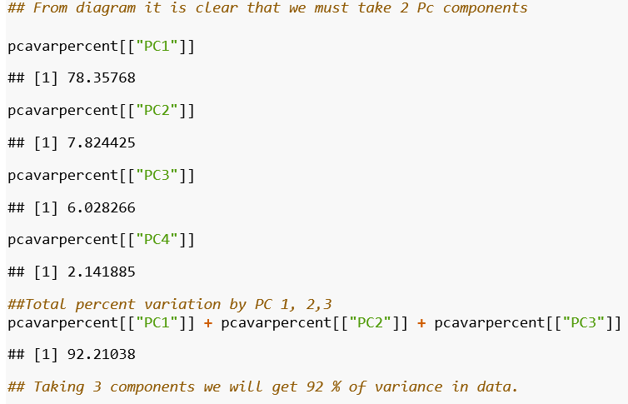

Slide 71
Reinforcement Learning
Reinforcement learning is an area of machine learning concerned with how software agents ought to take actions in an environment so as to maximize some notion of cumulative reward.
Reinforcement learning is one of three basic machine learning paradigms, alongside supervised learning and unsupervised learning. In reinforcement learning, an artificial intelligence faces a game-like situation.
The computer employs trial and error to come up with a solution to the problem. To get the machine to do what the programmer wants, the artificial intelligence gets either rewards or penalties for the actions it performs. Its goal is to maximize the total reward.

Slide 72
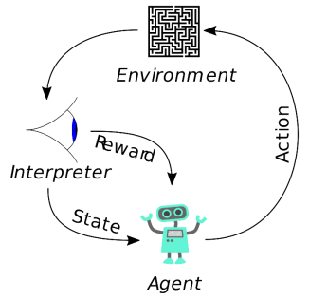
Reinforcement Learning

Slide 73
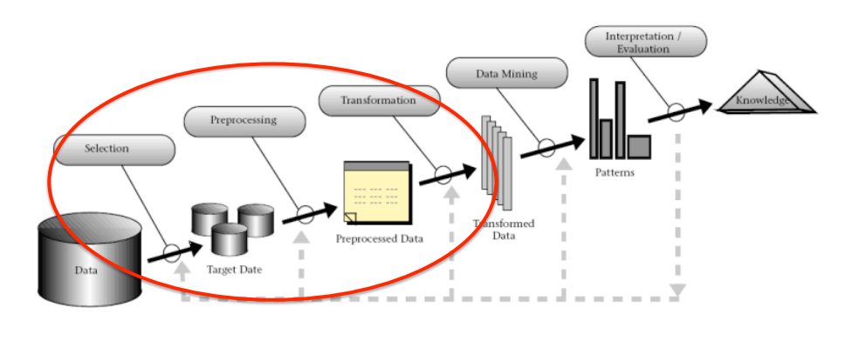
Knowledge Discovery in Databases
KDD may be defined as: "The non trivial process of identifying valid, novel, potentially useful, and ultimately understandable patterns in data" • KDD is an interactive and iterative process involving several steps.

Slide 74
Supervised learning vs. unsupervised learning
Supervised learning: discover patterns in the data that relate data attributes with a target (class) attribute.
These patterns are then utilized to predict the values of the target attribute in future data instances
Unsupervised learning: The data have no target attribute.
We want to explore the data to find some intrinsic structures in them.

Slide 75
Overfitting
•Fitting the data too well
•Features are noisy / uncorrelated to concept
•Modeling process very sensitive (powerful)
•Too much search

Slide 76
Underfitting
•Learning too little of the true concept
•Features don’t capture concept
•Too much bias in model
•Too little search to fit model

Slide 77
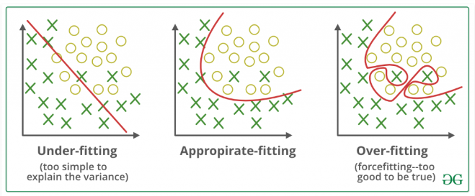
Under-fitting vs Appropirate-fitting Vs Over-fitting

Slide 78
Datasets
Training set: a set of examples used for learning, where the target value is known. • Validation set: a set of examples used to tune the architecture of a classifier and estimate the error.
• Test set: used only to assess the performances of a classifier. It is never used during the training process so that the error on the test set provides an unbiased estimate of the generalization error.

Slide 79
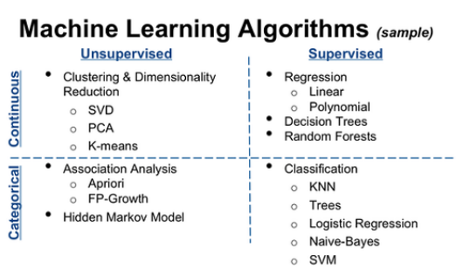
Machine Learning Algorithms

Slide 80
Thank You

